Slide 1
Data Warehouse Development Methodologies
Dibya Tara Shakya
ADB - A
Notes:
September 98
1
Chapter Name

Slide 2
Data Warehouse Development Methodologies
There are two main methodologies that incorporate the development of an enterprise data warehouse (EDW) and these are proposed by the two key players in the data warehouse arena.
  Kimball’s Business Dimensional Lifecycle (Kimball, 2008)
  Inmon’s Corporate Information Factory (CIF) methodology (Inmon, 2001).

Slide 3
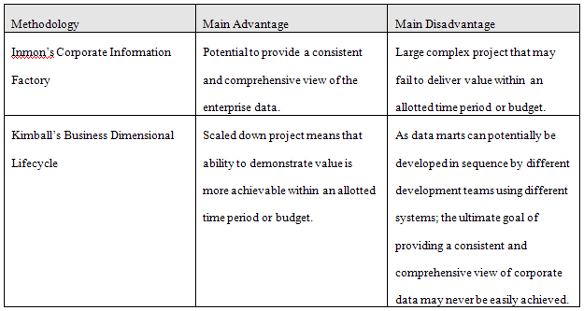
Data Warehouse Development Methodologies

Slide 4
Kimballs’ Business Dimensional Lifecycle
Ralph Kimball is a key player in DW.
About creation of an infrastructure capable of supporting all the information needs of an enterprise.
Uses new methods and techniques in the development of an enterprise data warehouse (EDW).

Slide 5
Kimballs’ Business Dimensional Lifecycle
Starts by identifying the information requirements (referred to as analytical themes) and associated business processes of the enterprise.
This activity results in the creation of a critical document called a Data Warehouse Bus Matrix.

Slide 6
Kimballs’ Business Dimensional Lifecycle
The matrix lists all of the key business processes of an enterprise together with an indication of how these processes are to be analysed.
The matrix is used to facilitate the selection and development of the first database (data mart) to meet the information requirements of a particular department of the enterprise.

Slide 7
Kimballs’ Business Dimensional Lifecycle
This first data mart is critical in setting the scene for the later integration of other data marts as they come online.
The integration of data marts ultimately leads to the development of an EDW.
Uses dimensionality modeling to establish the data model (called star schema) for each data mart.

Slide 8
Kimballs’ Business Dimensional Lifecycle
Guiding principle is to meet the information requirements of the enterprise by building a single, integrated, easy-to-use, high-performance information infrastructure, which is delivered in meaningful increments of 6 to 12 month timeframes.
Goal is to deliver the entire solution including the data warehouse, ad hoc query tools, reporting applications, advanced analytics and all the necessary training and support for the users.

Slide 9
Kimballs’ Business Dimensional Lifecycle
Has three tracks:
  technology (top track),
  data (middle track),
  business intelligence (BI) applications (bottom track).
Uses incremental and iterative approach that involves the development of data marts that are eventually integrated into an enterprise data warehouse (EDW).

Slide 10
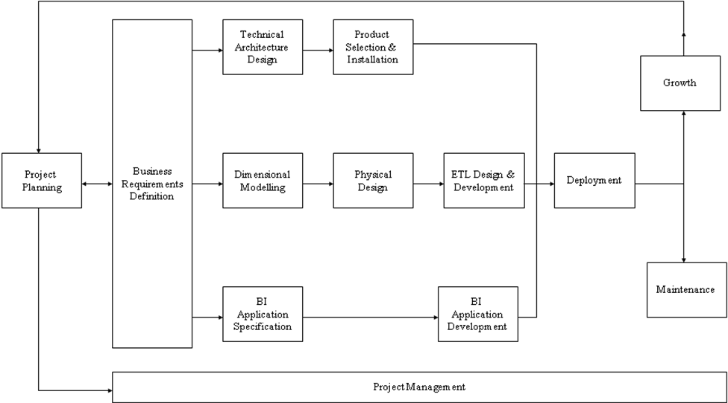
Kimballs’ Business Dimensional Lifecycle

Slide 11
Dimensionality modeling
A logical design technique that aims to present the data in a standard, intuitive form that allows for high-performance access
Every dimensional model (DM) is composed of one table with a composite primary key, called the fact table, and a set of smaller tables called dimension tables.

Slide 12
Dimensionality modeling
Each dimension table has a simple (non-composite) primary key that corresponds exactly to one of the components of the composite key in the fact table.
Forms ‘star-like’ structure, which is called a star schema or star join.

Slide 13
Dimensionality modeling
All natural keys are replaced with surrogate keys. Means that every join between fact and dimension tables is based on surrogate keys, not natural keys.
Surrogate keys allows the data in the warehouse to have some independence from the data used and produced by the OLTP systems.

Slide 14
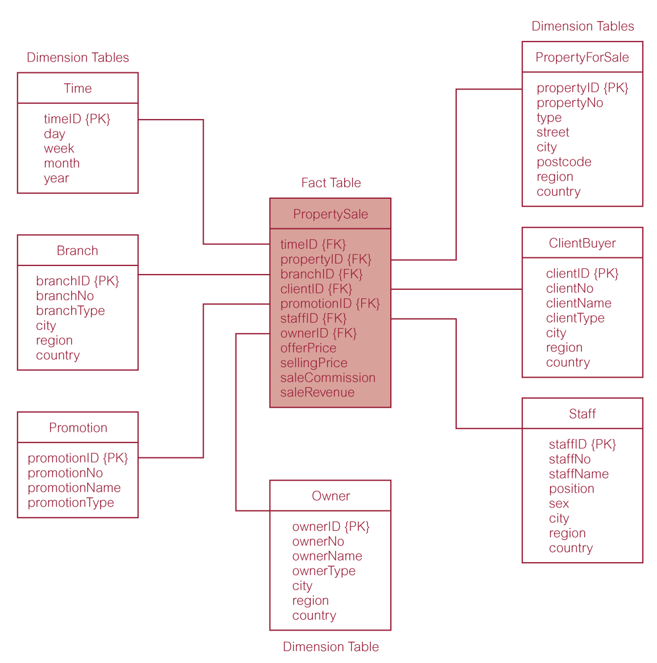
Star schema (dimensional model) for property sales of DreamHome

Slide 15
Dimensionality modeling
Star schema is a logical structure that has a fact table (containing factual data) in the center, surrounded by denormalized dimension tables (containing reference data).
Facts are generated by events that occurred in the past, and are unlikely to change, regardless of how they are analyzed.

Slide 16
Dimensionality modeling
Bulk of data in data warehouse is in fact tables, which can be extremely large.
Important to treat fact data as read-only reference data that will not change over time.
Most useful fact tables contain one or more numerical measures, or ‘facts’ that occur for each record and are numeric and additive.

Slide 17
Dimensionality modeling
Dimension tables usually contain descriptive textual information.
Dimension attributes are used as the constraints in data warehouse queries.
Star schemas can be used to speed up query performance by denormalizing reference information into a single dimension table.

Slide 18
Dimensionality modeling
Snowflake schema is a variant of the star schema that has a fact table in the center, surrounded by normalized dimension tables .
Starflake schema is a hybrid structure that contains a mixture of star (denormalized) and snowflake (normalized) dimension tables.

Slide 19
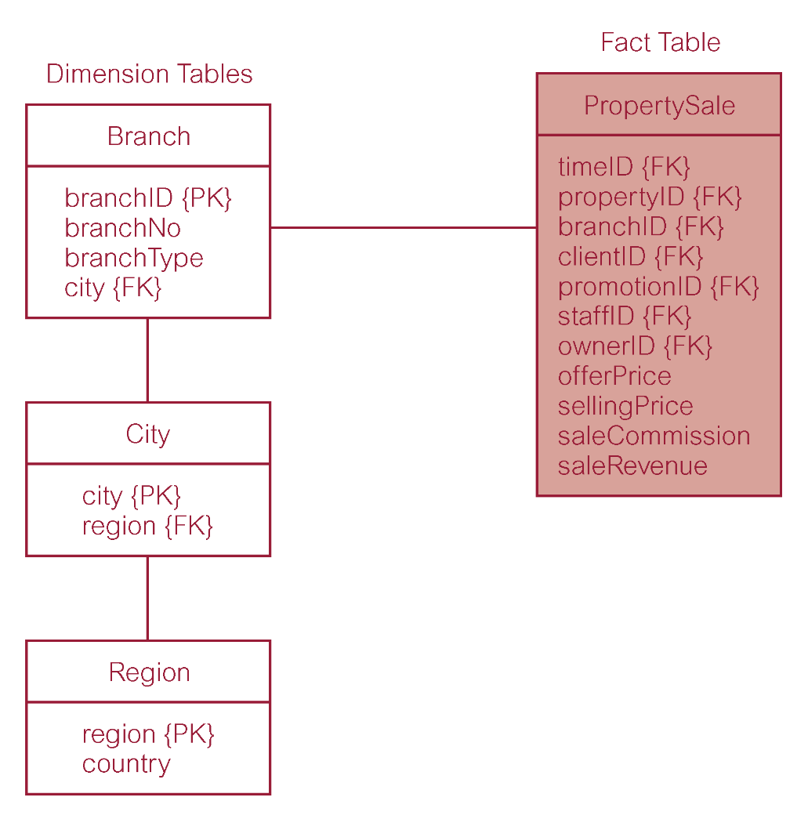
Property sales with normalized version of Branch dimension table

Slide 20
Dimensionality modeling
Predictable and standard form of the underlying dimensional model offers important advantages:
  Efficiency
  Ability to handle changing requirements
  Extensibility
  Ability to model common business situations
  Predictable query processing

Slide 21
Comparison of DM and ER models
A single ER model normally decomposes into multiple DMs.
Multiple DMs are then associated through ‘shared’ dimension tables.

Slide 22
Dimensional Modeling Stage of Kimball’s Business Dimensional Lifecycle
Begins by defining a high-level dimension model (DM), which progressively gains more detail and this is achieved using a two-phased approach.
The first phase is the creation of the high-level DM and the second phase involves adding detail to the model through the identification of dimensional attributes for the model.

Slide 23

Dimensional Modeling Stage of Kimball’s Business Dimensional Lifecycle
Phase 1 involves the creation of a high-level dimensional model (DM) using a four-step process.

Slide 24
Step 1: Select business process
The process (function) refers to the subject matter of a particular data mart.
First data mart built should be the one that is most likely to be delivered on time, within budget, and to answer the most commercially important business questions.

Slide 25
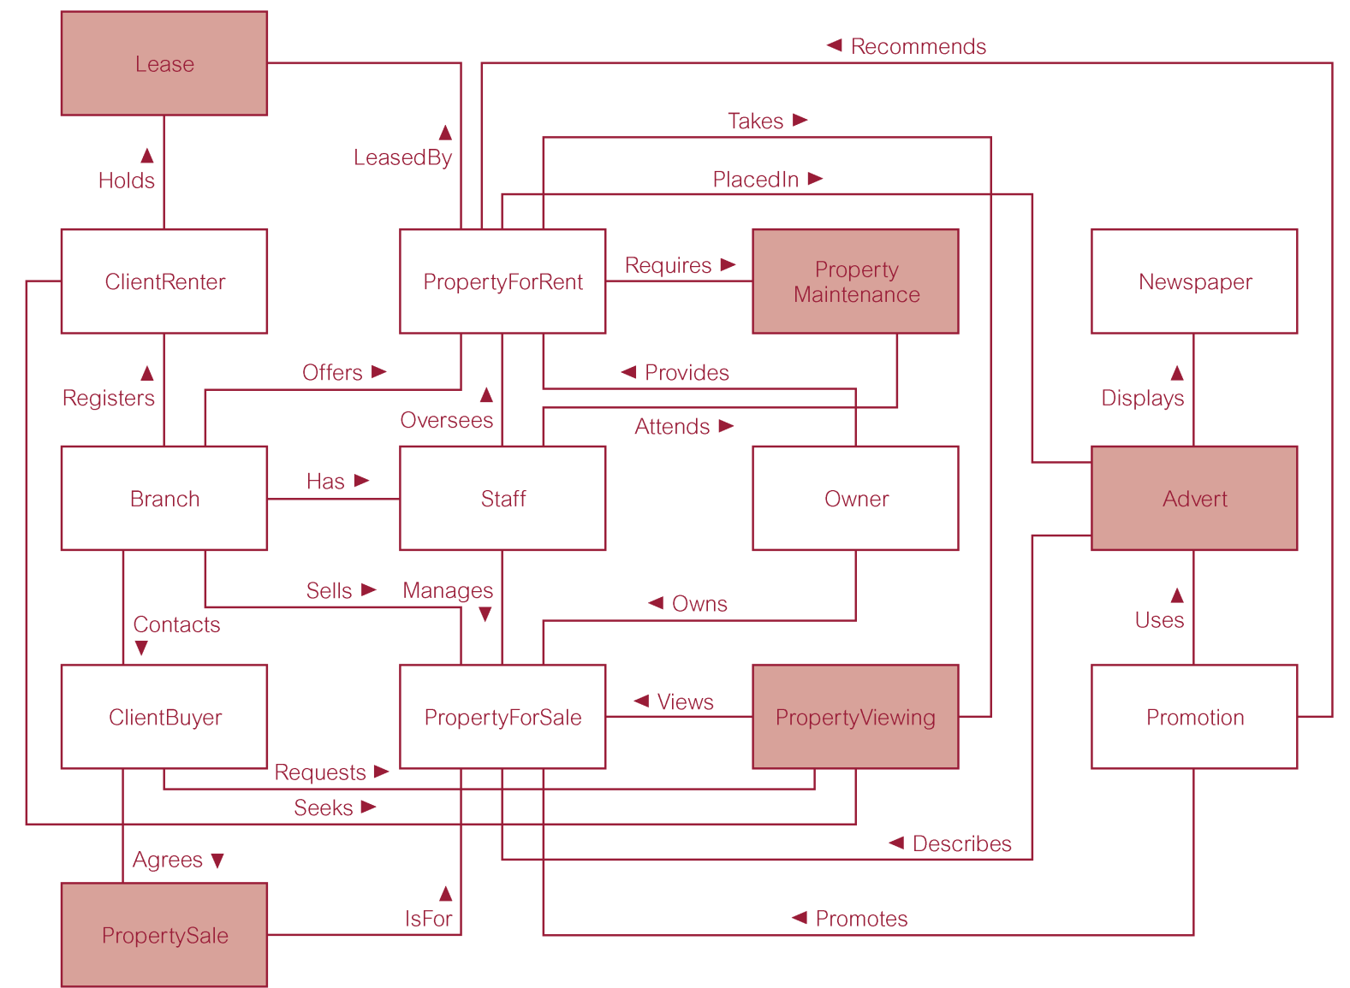
ER model of an extended version of DreamHome

Slide 26
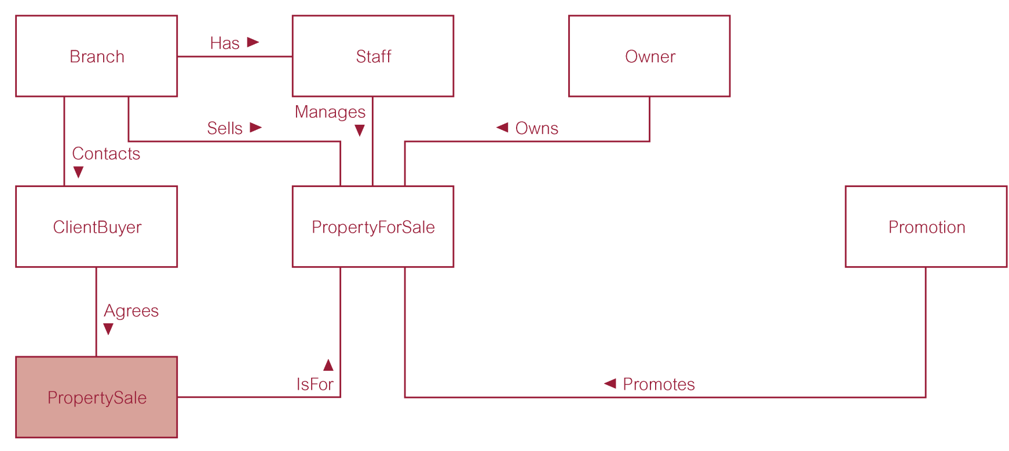
ER model of property sales business process of DreamHome

Slide 27
Step 2: Declare grain
Decide what a record of the fact table is to represents.
Identify dimensions of the fact table. The grain decision for the fact table also determines the grain of each dimension table.
Also include time as a core dimension, which is always present in star schemas.

Slide 28
Step 3: Choose dimensions
Dimensions set the context for asking questions about the facts in the fact table.
If any dimension occurs in two data marts, they must be exactly the same dimension, or one must be a mathematical subset of the other.
A dimension used in more than one data mart is referred to as being conformed.

Slide 29
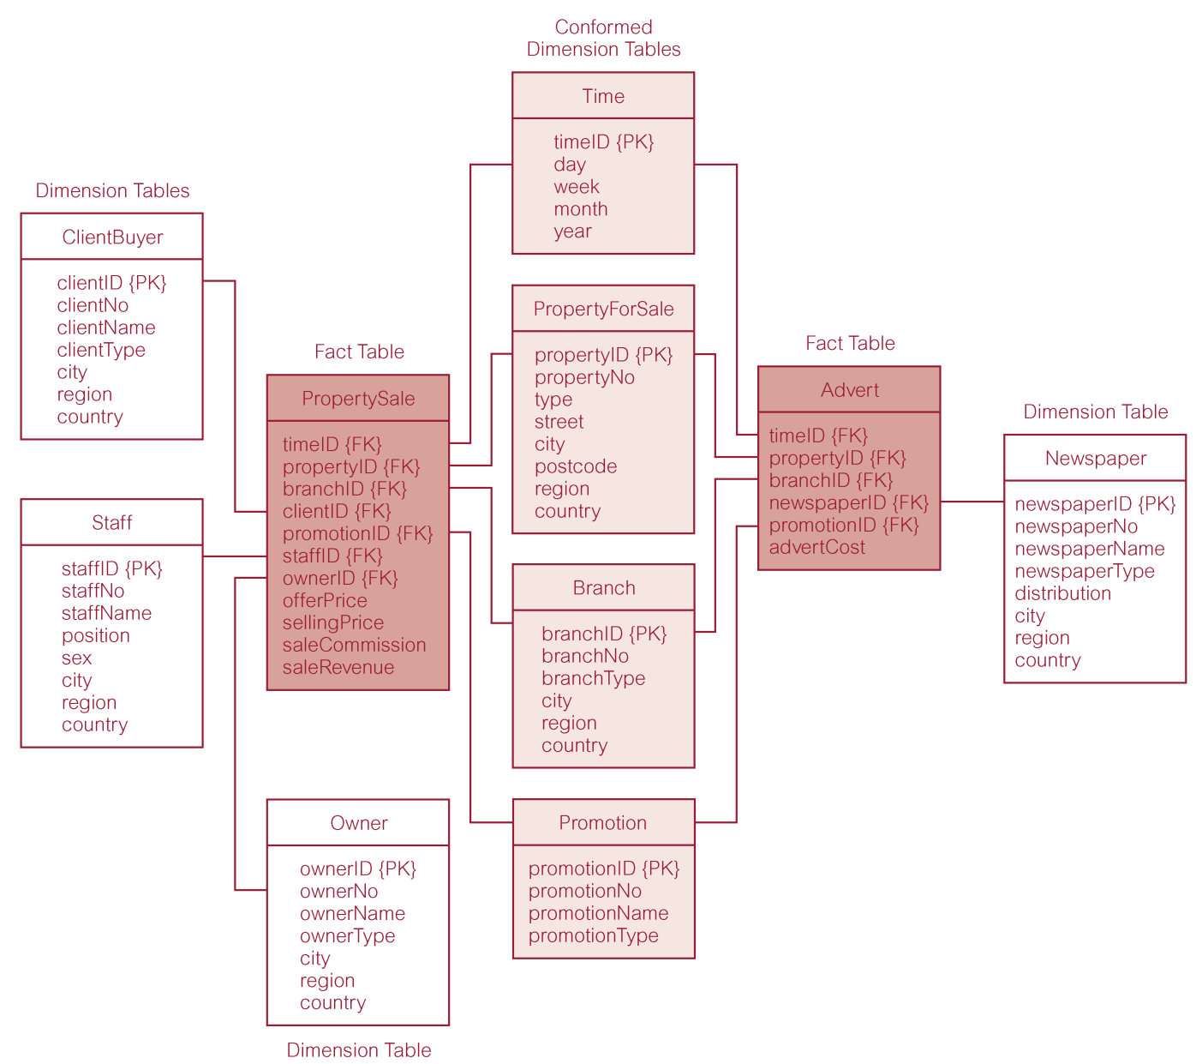
Star schemas for property sales and property advertising

Slide 30
Step 4: Identify facts
The grain of the fact table determines which facts can be used in the data mart.
Facts should be numeric and additive.
Unusable facts include:
  non-numeric facts
  non-additive facts
  fact at different granularity from other facts in table

Slide 31
Step 4: Identify facts
Once the facts have been selected each should be re-examined to determine whether there are opportunities to use pre-calculations.

Slide 32
Kimball’s Business Dimensional lifecycle
Lifecycle produces a data mart that supports the requirements of a particular business process and allows the easy integration with other related data marts to form the enterprise-wide data warehouse.
A dimensional model, which contains more than one fact table sharing one or more conformed dimension tables, is referred to as a fact constellation.

